Slide 1
A to B
PowerPoint Timeline
TOOLKIT

Slide 2
A to B - Timeline 5
5 BOX – A to B Timeline
JANUARY 1ST
Use this box to write a description.
JUNE 5TH
Getting from A to B. Document it in this timeline.
OCT. 5TH
Remove any of the elements to customize it to fit your project.
MARCH 3RD
Delete or remove any of the pages, boxes or elements from this presentation.
DECEMBER 12TH
This page can be duplicated.

Slide 3
A to B - Timeline 5
4 BOX – A to B Timeline
JANUARY 1ST
Use this box to write a description.
JUNE 5TH
Getting from A to B. Document it in this timeline.
MARCH 3RD
Delete or remove any of the pages, boxes or elements from this presentation.
DECEMBER 12TH
This page can be duplicated.

Slide 4
A to B - Timeline 5
3 BOX – A to B Timeline
JANUARY 1ST
Use this box to write a description.
JUNE 5TH
Getting from A to B. Document it in this timeline.
MARCH 3RD
Delete or remove any of the pages, boxes or elements from this presentation.

Slide 5
A to B - Timeline 5
2 BOX – A to B Timeline
JANUARY 1ST
Use this box to write a description.
DECEMBER 3RD
Delete or remove any of the pages, boxes or elements from this presentation.

Slide 6
A to B - Timeline 5
1 BOX – A to B Timeline
JANUARY 1ST
Use this box to write a description.

Slide 7
Changing theme Colors in PowerPoint 2013 and newer
4. Select Customize Colors and continue to slide 18.
3. Select Colors
2. Select This Arrow
1. Click on the design tab

Slide 8
Changing theme Colors in PowerPoint 2010
3. Create New Theme Colors and continue to Slide 18
2. Select Colors
1. Click on the design tab

Slide 9
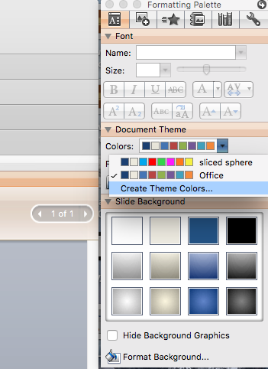
Change Theme Colors PowerPoint Mac 2008
1. Expand Document Theme
2. Click Create Theme Colors
3. Change Accent Colors

Slide 10
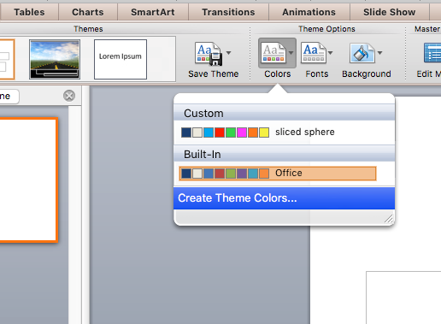
Change Theme Colors PowerPoint Mac 2011
1. Expand Document Theme
2. Click Create Theme Colors
3. Change Accent Colors

Slide 11
Changing theme Colors
All the accents plus the Text/Background-Dark2 are what control the colors in this template.
Left click on a color drop down to bring up the colors.
The top square that is highlighted is the main color, select it and change its color.
Click on More Colors to edit RBG values and select new colors.
Create a new name for your theme and click the save button at the bottom.

Slide 12
Questions? More Information?
PresenterMedia.com
support@presentermedia.com
4416 S. Technology Dr
Sioux Falls, SD 57106

