Slide 1
BOX
LADDER
An Animated Presentation Template

Slide 2
Box Ladder: Slide 1
TOPIC 3
TOPIC 4
The quick brown fox
jump over the lazy dog. The quick brown fox jump over the lazy dog.
The quick brown fox
jump over the lazy dog. The quick brown fox jump over the lazy dog.
TOPIC 1
TOPIC 2
The quick brown fox
jump over the lazy dog. The quick brown fox jump over the lazy dog.
The quick brown fox
jump over the lazy dog. The quick brown fox jump over the lazy dog.

Slide 3
Box Ladder: Slide 2
1
2
3
STAT 1
STAT 2
STAT 3
STEP
STEP
STEP
OVERVIEW
OVERVIEW
OVERVIEW
The quick brown fox jump over the lazy dog
The quick brown fox jump over the lazy dog
The quick brown fox jump over the lazy dog
The quick brown fox
jumped over the lazy dog. The quick brown fox jumped over the lazy dog.

Slide 4
Box Ladder: Slide 3
40%
2
STAT 2
30%
STAT 2 The quick brown fox jump over the lazy dog
30%
STAT 3
3
1
STAT 1
STAT 3 The quick brown fox jump over the lazy dog
STAT 1 The quick brown fox jump over the lazy dog
The quick brown fox
jumped over the lazy dog. The quick brown fox jumped over the lazy dog.

Slide 5
Box Ladder: Slide 4
OVERVIEW
The quick brown fox jumped over the lazy dog
STAT 1 The quick brown fox jumped over the lazy dog
01
OVERVIEW
STAT 2 The quick brown fox jumped over the lazy dog
The quick brown fox jumped over the lazy dog
02
OVERVIEW
STAT 3 The quick brown fox jumped over the lazy dog
The quick brown fox jumped over the lazy dog
03

Slide 6
Box Ladder : Slide 5
The quick brown fox
jumped over the lazy dog. The quick brown fox jumped over the lazy dog.
TOPIC 3 The quick brown fox jumped
TOPIC 3
TOPIC 2
The quick brown fox
jumped over the lazy dog. The quick brown fox jumped over the lazy dog.
TOPIC 2 The quick brown fox jumped
TOPIC 1
The quick brown fox
jumped over the lazy dog. The quick brown fox jumped over the lazy dog.
TOPIC 1 The quick brown fox jumped

Slide 7
Box Ladder: Slide 6
80%
The quick brown fox jumped over the lazy dog
100%
The quick brown fox jumped over the lazy dog
40%
The quick brown fox jumped over the lazy dog
60%
The quick brown fox jumped over the lazy dog
TITLE HERE
20%
The quick brown fox jumped over the lazy dog
START

Slide 8
Changing theme Colors in PowerPoint 2013 and newer
4. Select Customize Colors and continue to slide 18.
3. Select Colors
2. Select This Arrow
1. Click on the design tab

Slide 9
Changing theme Colors in PowerPoint 2010
3. Create New Theme Colors and continue to Slide 18
2. Select Colors
1. Click on the design tab

Slide 10
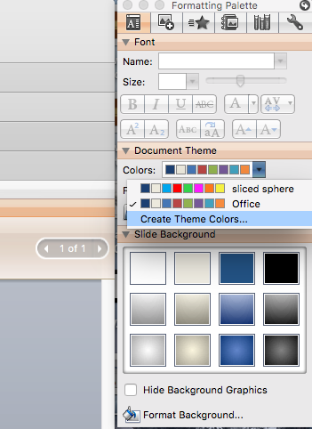
Change Theme Colors PowerPoint Mac 2008
1. Expand Document Theme
2. Click Create Theme Colors
3. Change Accent Colors

Slide 11
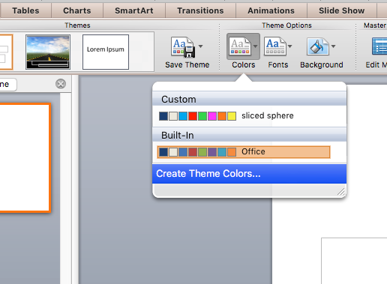
Change Theme Colors PowerPoint Mac 2011
1. Expand Document Theme
2. Click Create Theme Colors
3. Change Accent Colors

Slide 12
Changing the Individual Accent theme Colors
All the accents plus the Text/Background-Dark2 are what control the colors in this template.
Left click on a color drop down to bring up the colors.
The top square that is highlighted is the main color, select it and change its color.
Click on More Colors to edit RBG values and select new colors.
Create a new name for your theme and click the save button at the bottom.

Slide 13
Questions? More Information?
PresenterMedia.com
support@presentermedia.com
4416 S. Technology Dr
Sioux Falls, SD 57106

