Slide 1
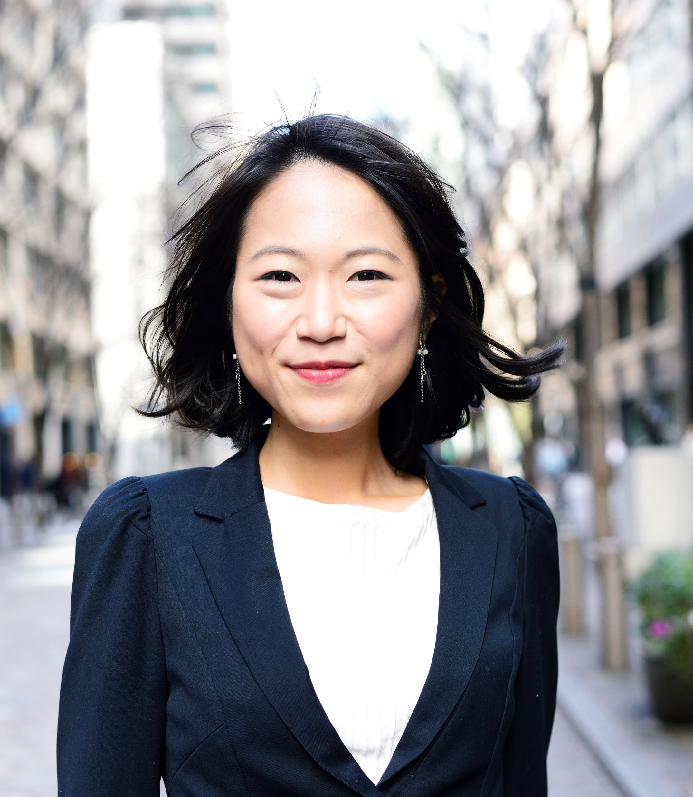
Celebration!
THE LIFE OF
JANE DOE
April 22nd – Present

Slide 2
The Story
This is the story of this great person who did these great things. They live life to the fullest and touch many hearts. This is the story of this great person who did these great things. They live life to it fullest and touch many hearts.
This is the story of this great person who did these great things. They live life to the fullest and touch many hearts. This is the story of this great person who did these great things. They live life to it fullest and touch many hearts.
This is the story of this great person who did these great things. They live life to the fullest and touch many hearts. This is the story of this great person who did these great things. They live life to it fullest and touch many hearts.
This is the story of this great person who did these great things. They live life to the fullest and touch many hearts. This is the story of this great person who did these great things. They live life to it fullest and touch many hearts.

Slide 3
The Story Cont.…
This is the story of this great person who did these great things. They live life to the fullest and touch many hearts. This is the story of this great person who did these great things. They live life to it fullest and touch many hearts.
This is the story of this great person who did these great things. They live life to the fullest and touch many hearts. This is the story of this great person who did these great things. They live life to it fullest and touch many hearts.
This is the story of this great person who did these great things. They live life to the fullest and touch many hearts. This is the story of this great person who did these great things. They live life to it fullest and touch many hearts.
This is the story of this great person who did these great things. They live life to the fullest and touch many hearts. This is the story of this great person who did these great things. They live life to it fullest and touch many hearts.

Slide 4
Fond Memories

Slide 5
Fond Memories

Slide 6
Achievement
Graduated with honors from a great college.

Slide 7
A Beautiful Time
This was an amazing experience they treasured.

Slide 8
Fun Memories

Slide 9
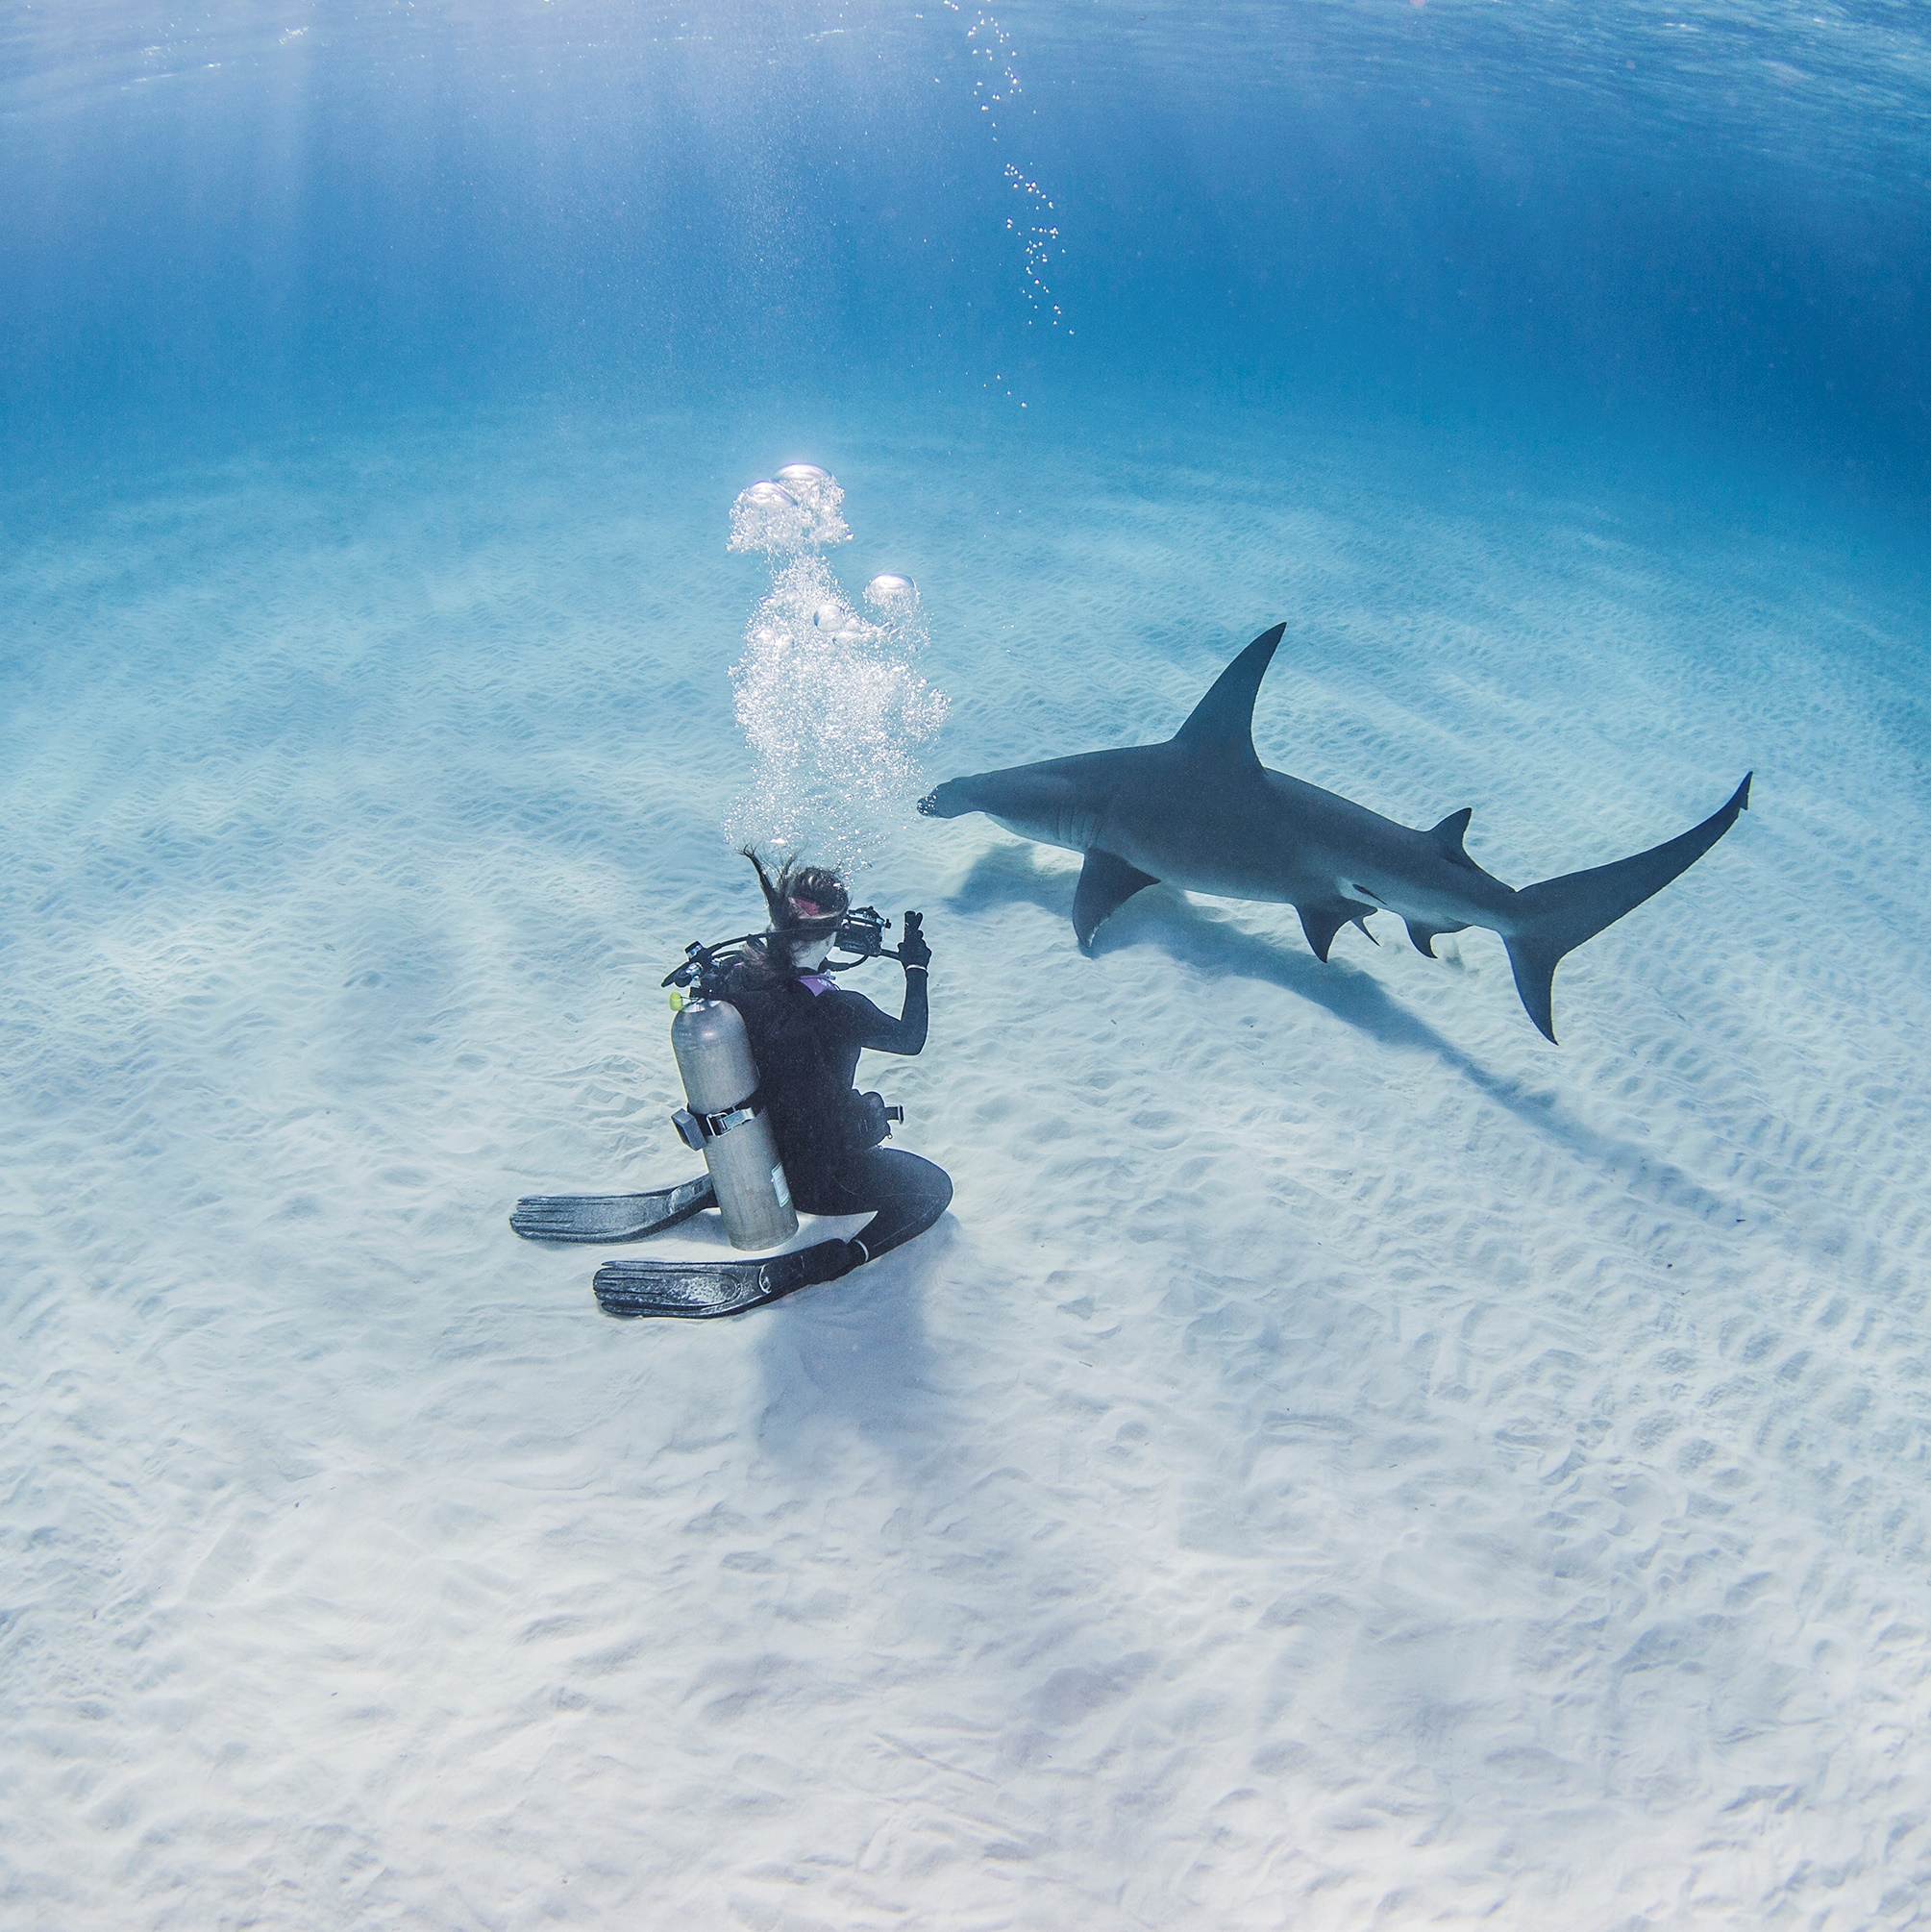
Adventure Memories

Slide 10
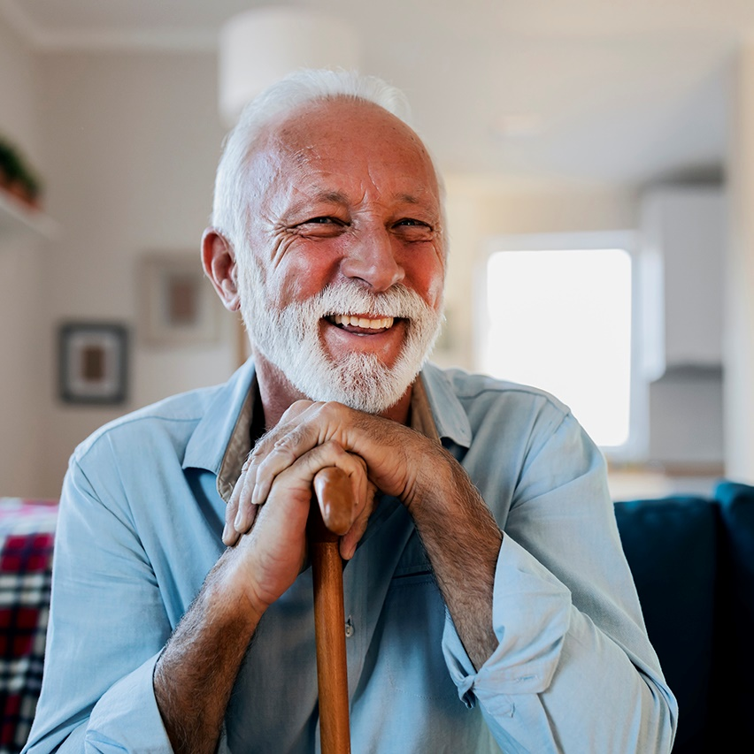
Five Picture Memories

Slide 11
Seven Picture Memories

Slide 12
Replacing Pictures in the Template
1. Double click to select the picture.
2. Right mouse click on the image.
3. Choose Change Graphic.
4. Select the new picture from This Device , From Stock Images, From Icons.

Slide 13
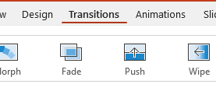
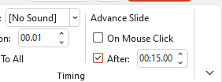
Change Length of the Slide Time
1. Select Transitions from the top menu.
2. Choose After check box.
3. Change how many seconds you would like the slide to play before switching to the next.

Slide 14
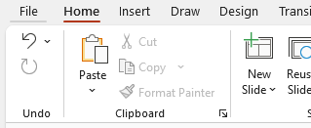
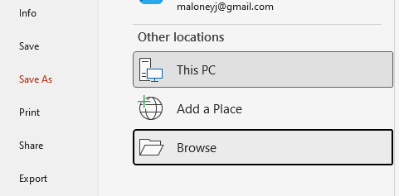
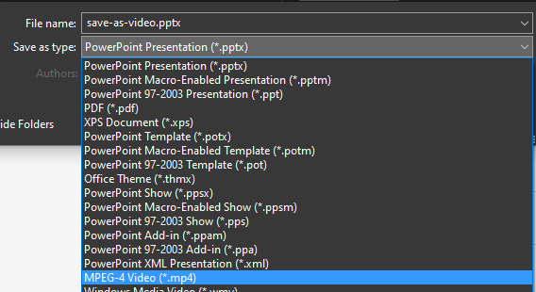
Save Presentation as a Video
1. Select File from the top menu.
2. Choose Save As > This PC > Browes.
3. Select MPEG-4 Video and Click Save.

Slide 15
Changing theme Colors in PowerPoint 2013 and newer
4. Select Customize Colors.
1. Click on the design tab
3. Select Colors
2. Select This Arrow

Slide 16
Changing theme Colors in PowerPoint 2010
3. Create New Theme Colors.
2. Select Colors
1. Click on the design tab

Slide 17
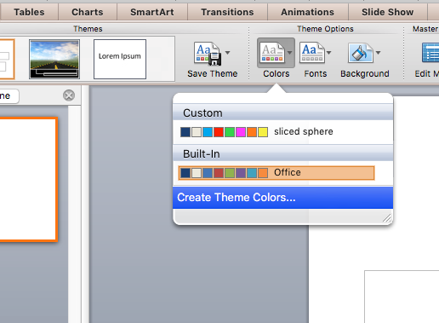
Changing theme Colors in PowerPoint Mac 2011
1. Expand Document Theme
2. Click Create Theme Colors
3. Change Accent Colors

Slide 18
Changing theme ACCENT Colors
All the accents plus the Text/Background-Dark2 are what control the colors in this template.
Left click on a color drop down to bring up the colors.
The top square that is highlighted is the main color, select it and change its color.
Click on More Colors to edit RBG values and select new colors.
Create a new name for your theme and click the save button at the bottom.

Slide 19
Remove Animation from any slide
1. Go to the slide you would like to remove the animation from.
3. With everything on that slide selected, go to the animation menu and select None.
2. Hold Ctrl and press a on you keyboard to select all.
If on a Mac hold Command and press a.

Slide 20
Questions? More Information?
PresenterMedia.com
support@presentermedia.com
(605) 274-2424

