Slide 1
The Law
Animated Template
Notes:
https://unsplash.com/photos/RDYdOvk8ats

Slide 2
Content Page Title
This is the sample dummy text insert your desired text.
This is the sample dummy text insert your desired text.
This is the sample dummy text insert your desired text.
This is the sample dummy text insert your desired text.
The Law
2
Animated Template
www.thelawtemplate.com

Slide 3
Your Title Goes Here.
This is the sample dummy text insert your desired text.
Add Title Here.
This is the sample dummy text insert your desired text.
ADD TITLE HERE.
This is the sample dummy text insert your desired text.
ADD TITLE HERE.
This is the sample dummy text insert your desired text.
The Law
Animated Template
www.thelawtemplate.com
Notes:
https://unsplash.com/photos/B6JINerWMz0

Slide 4
Law Services
This is the sample dummy text insert your desired text.
Subtitle Text #01
Subtitle Text #02
Subtitle Text #03
Subtitle Text #04
This is the sample dummy text insert your desired text.
This is the sample dummy text insert your desired text.
This is the sample dummy text insert your desired text.
This is the sample dummy text insert your desired text.
The Law
Animated Template
www.thelawtemplate.com
Notes:
https://unsplash.com/photos/webyw4NsFPg
https://unsplash.com/photos/Oalh2MojUuk
https://unsplash.com/photos/5QgIuuBxKwM

Slide 5
The Law Team
This is the sample dummy text insert your desired text.
TOM H.
JULIE M.
JONE S.
SALLY L.
Post Title
Post Title
Post Title
Post Title
This is the sample dummy text insert your desired text.
This is the sample dummy text insert your desired text.
This is the sample dummy text insert your desired text.
This is the sample dummy text insert your desired text.
Notes:
https://pixabay.com/photos/model-nice-makeup-beauty-young-1814200/
https://unsplash.com/photos/pAtA8xe_iVM
https://unsplash.com/photos/16aAmc4f7fA
https://pixabay.com/photos/reader-teacher-consultant-advisor-4507506/

Slide 6
Our Mission & Goal
This is the sample dummy text insert your desired text.
OUR MISSION
OUR GOAL
This is the sample dummy text insert your desired text. This is the sample dummy text insert your desired text.
This is the sample dummy text insert your desired text. This is the sample dummy text insert your desired text.
The Law
Animated Template
www.thelawtemplate.com

Slide 7
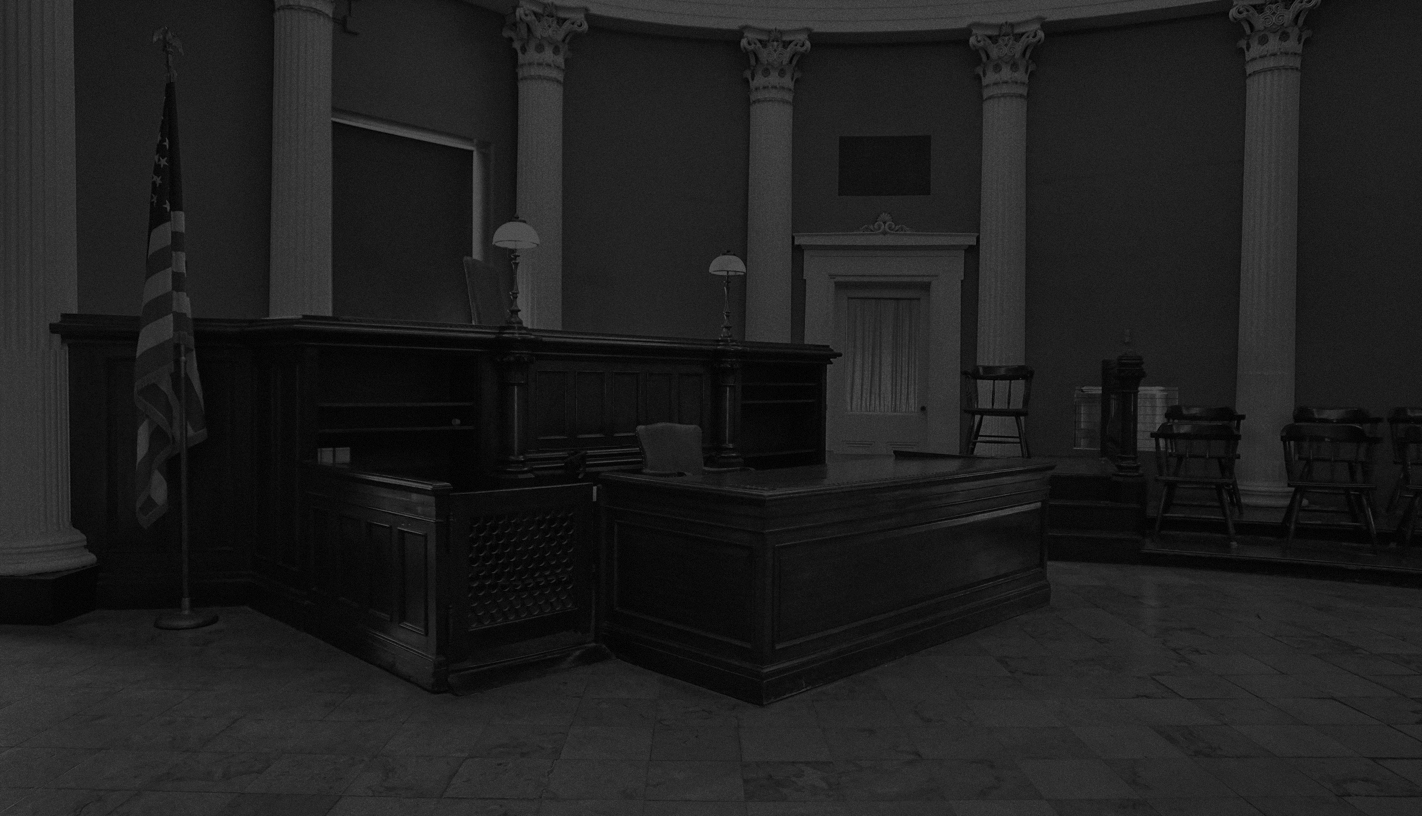
Your Title Can Be Here
This is the sample dummy text insert your desired text.
2025
2035
2045
Title One
Title Three
Title Five
This is the sample dummy text insert your desired text
This is the sample dummy text insert your desired text
This is the sample dummy text insert your desired text
2030
2040
Title Two
Title Four
This is the sample dummy text insert your desired text
This is the sample dummy text insert your desired text
The Law
7
Animated Template
www.thelawtemplate.com

Slide 8
Your Title Can Be Here
This is the sample dummy text insert your desired text.
Subtitle Text #01
Subtitle Text #03
This is the sample dummy text insert your desired text.
This is the sample dummy text insert your desired text.
Subtitle Text #02
Subtitle Text #04
This is the sample dummy text insert your desired text.
This is the sample dummy text insert your desired text.
The Law
Animated Template
www.thelawtemplate.com

Slide 9
Your Title Can Be Here
This is the sample dummy text insert your desired text.
Subtitle Text #01
Subtitle Text #03
This is the sample dummy text insert your desired text.
This is the sample dummy text insert your desired text.
Subtitle Text #02
Subtitle Text #04
This is the sample dummy text insert your desired text.
This is the sample dummy text insert your desired text.
The Law
Animated Template
www.thelawtemplate.com

Slide 10
Your Title Can Be Here
This is the sample dummy text insert your desired text.
TITLE HERE
01
This is the sample dummy text insert your desired text.
80%
TITLE HERE
02
This is the sample dummy text insert your desired text.
62%
TITLE HERE
03
40%
This is the sample dummy text insert your desired text.
TITLE HERE
04
22%
This is the sample dummy text insert your desired text.
17%
05
TITLE HERE
This is the sample dummy text insert your desired text.
The Law
10
Animated Template
www.thelawtemplate.com

Slide 11
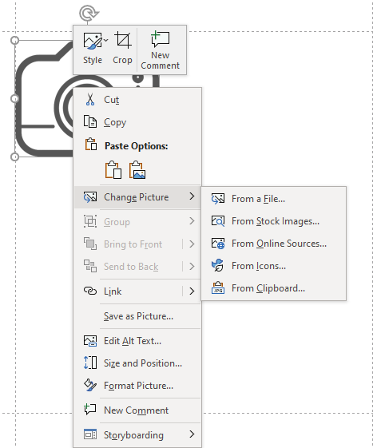
Replacing the Icons in this Template
1.Left click on the element to select the icon.
NOTE – In PowerPoint 365 you can select icons from PowerPoint’s icon library. (From Icons)
2. Once selected, right click and choose change picture.
3. Browse on your computer for the image or icon you would like to replace with, or select From icons.
NOTE – You can also delete the icon by following steps 1 and 2 and hitting delete once the icon is selected.

Slide 12
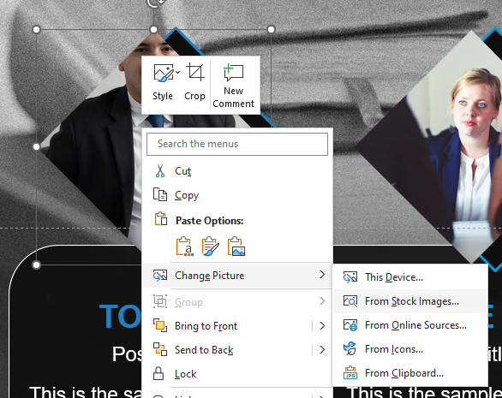
Replacing Pictures in the Template
1. Right click on the Picture
2. Select Change Pictures.
3. Choose from options.

Slide 13
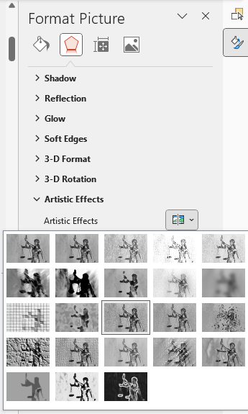
Add / Remove Film Grain Effect on Pictures
1. Right click on the Picture and select Format Background.
2. Select the Effects icon.
2. Click on Artistic Effects to the options.
4. Choose Film Grain from the options.
*Note – If you let your mouse sit on top of a Artistic thumbnail it will give you the name of that effect.

Slide 14
Changing theme Colors in PowerPoint 2013 and newer
4. Select Customize Colors.
1. Click on the design tab
3. Select Colors
2. Select This Arrow

Slide 15
Changing theme Colors in PowerPoint 2010
3. Create New Theme Colors.
2. Select Colors
1. Click on the design tab

Slide 16
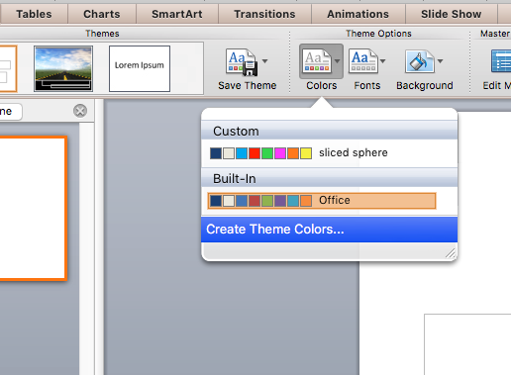
Changing theme Colors in PowerPoint Mac 2011
1. Expand Document Theme
2. Click Create Theme Colors
3. Change Accent Colors

Slide 17
Changing theme ACCENT Colors
All the accents plus the Text/Background-Dark2 are what control the colors in this template.
Left click on a color drop down to bring up the colors.
The top square that is highlighted is the main color, select it and change its color.
Click on More Colors to edit RBG values and select new colors.
Create a new name for your theme and click the save button at the bottom.

Slide 18
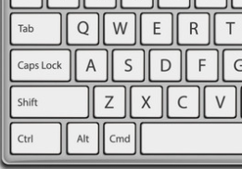
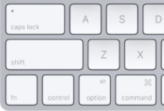
Remove Animation from any slide
1. Go to the slide you would like to remove the animation from.
3. With everything on that slide selected, go to the animation menu and select None.
2. Hold Ctrl and press a on you keyboard to select all.
If on a Mac hold Command and press a.

Slide 19
Questions? More Information?
PresenterMedia.com
support@presentermedia.com
(605) 274-2424

