Slide 1
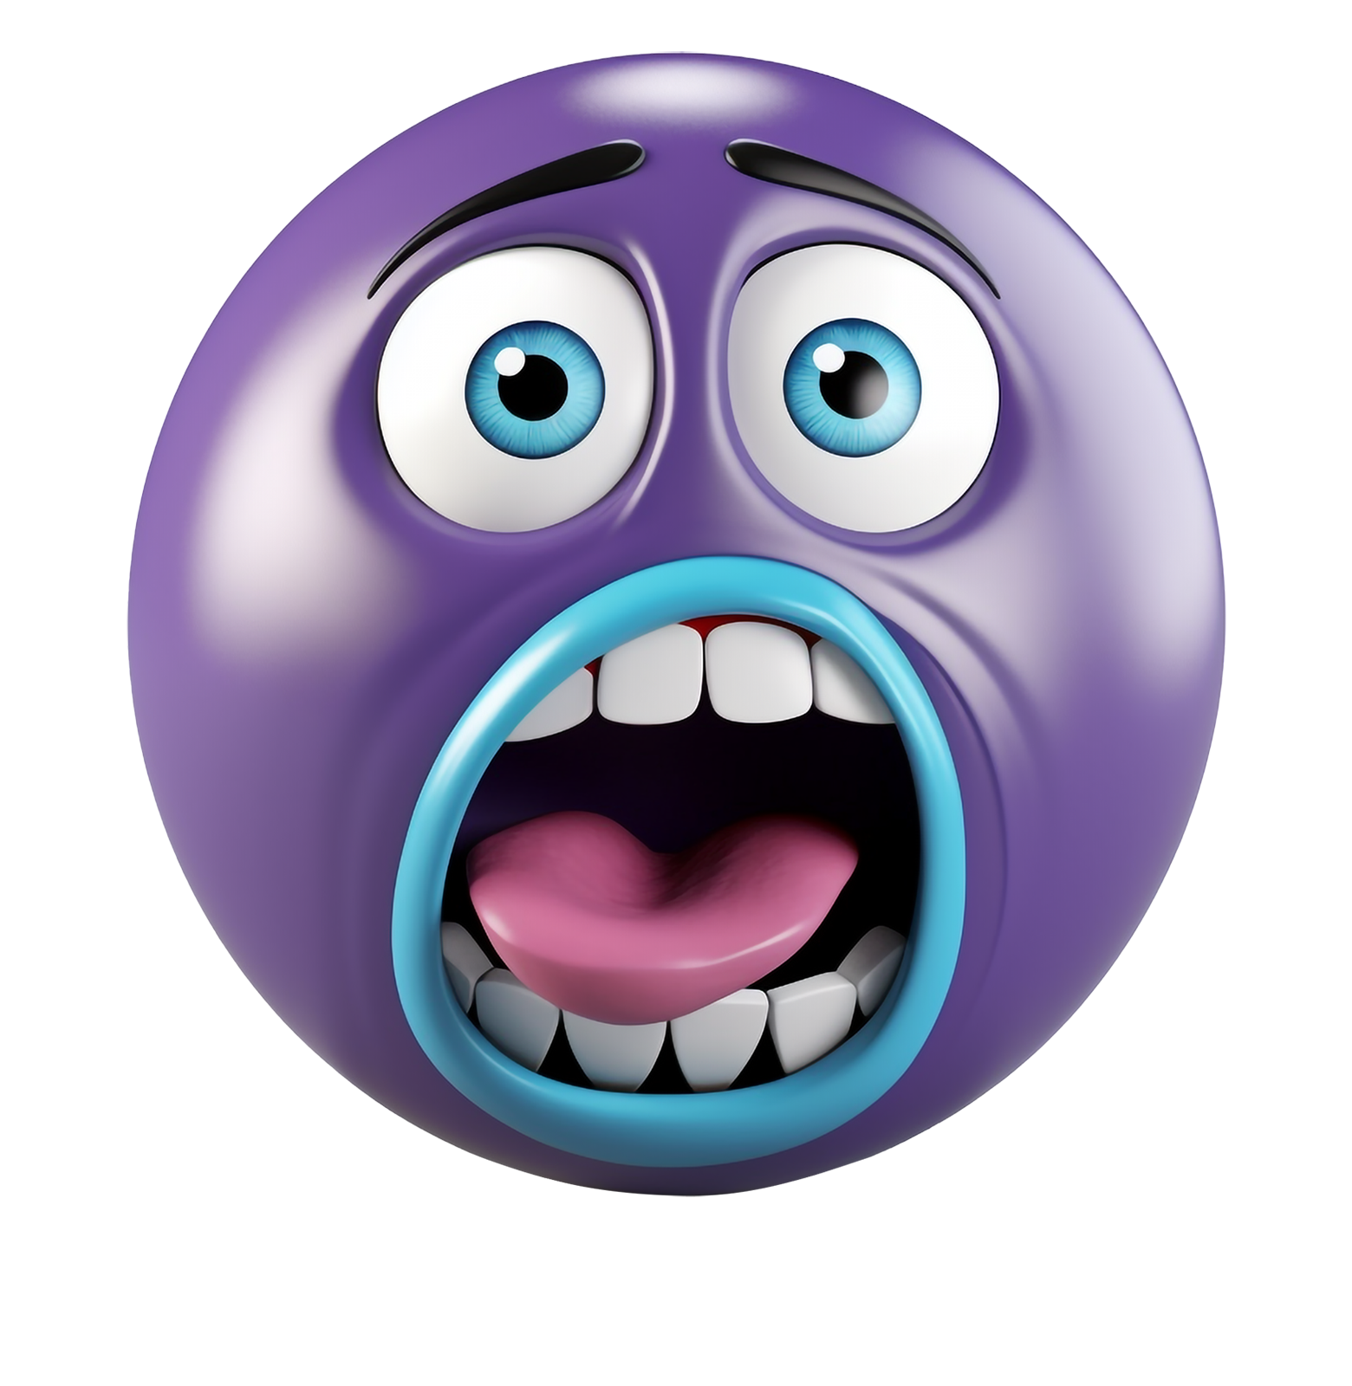
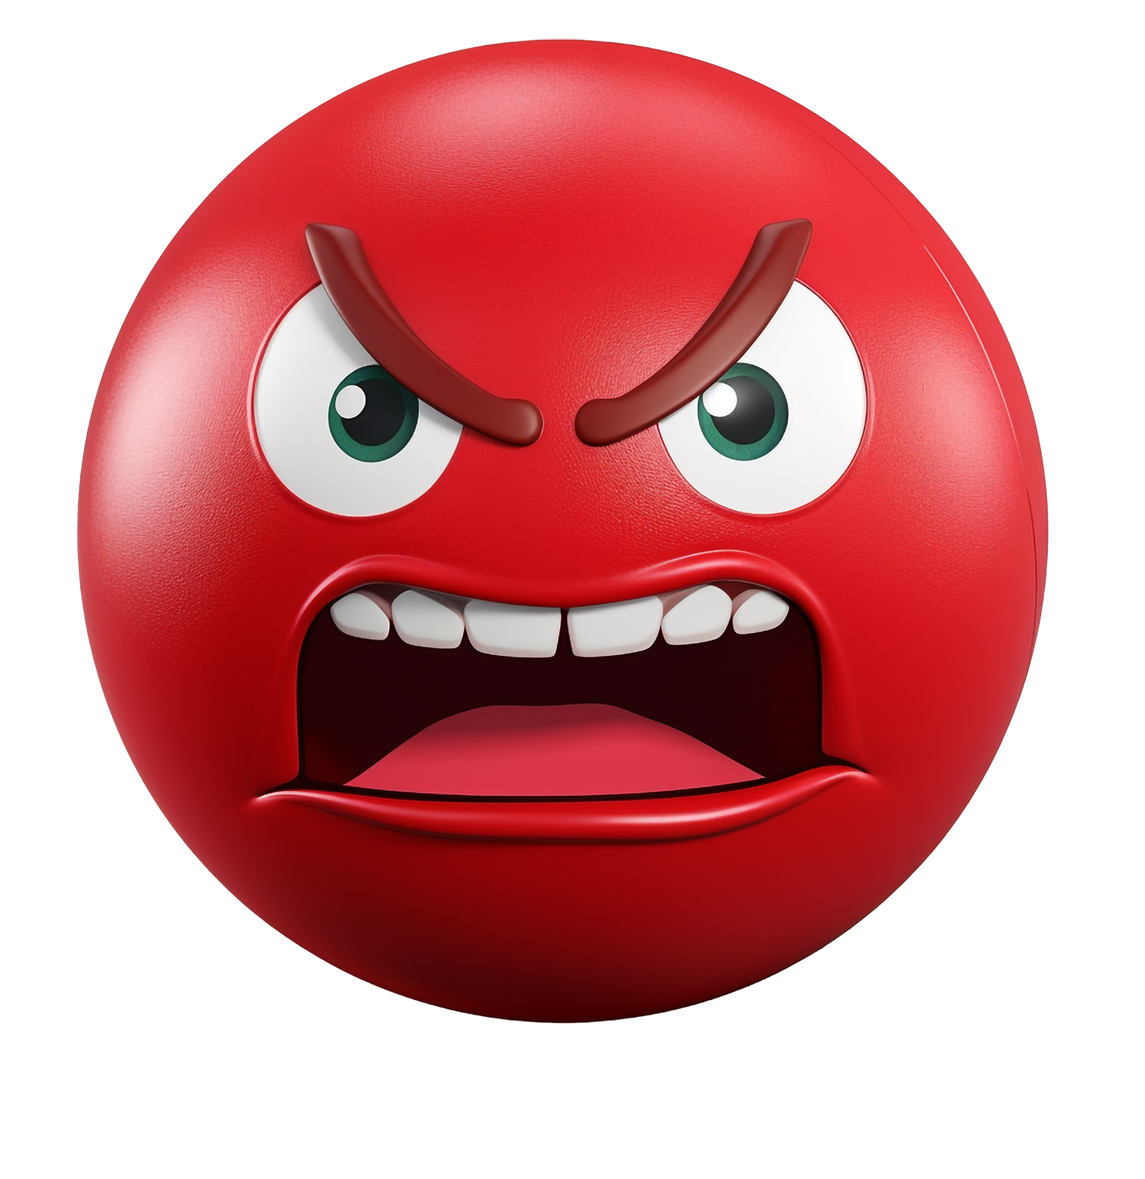
Emotion Scale - Do not delete – used for Hyperlink
i
K
d
s
EMOTION SCALE
Being aware of kids' emotions is about nurturing their emotional intelligence, which has a profound impact on their overall well-being, relationships, and success in various aspects of life. It helps them develop into emotionally healthy and socially competent individuals.

Slide 2
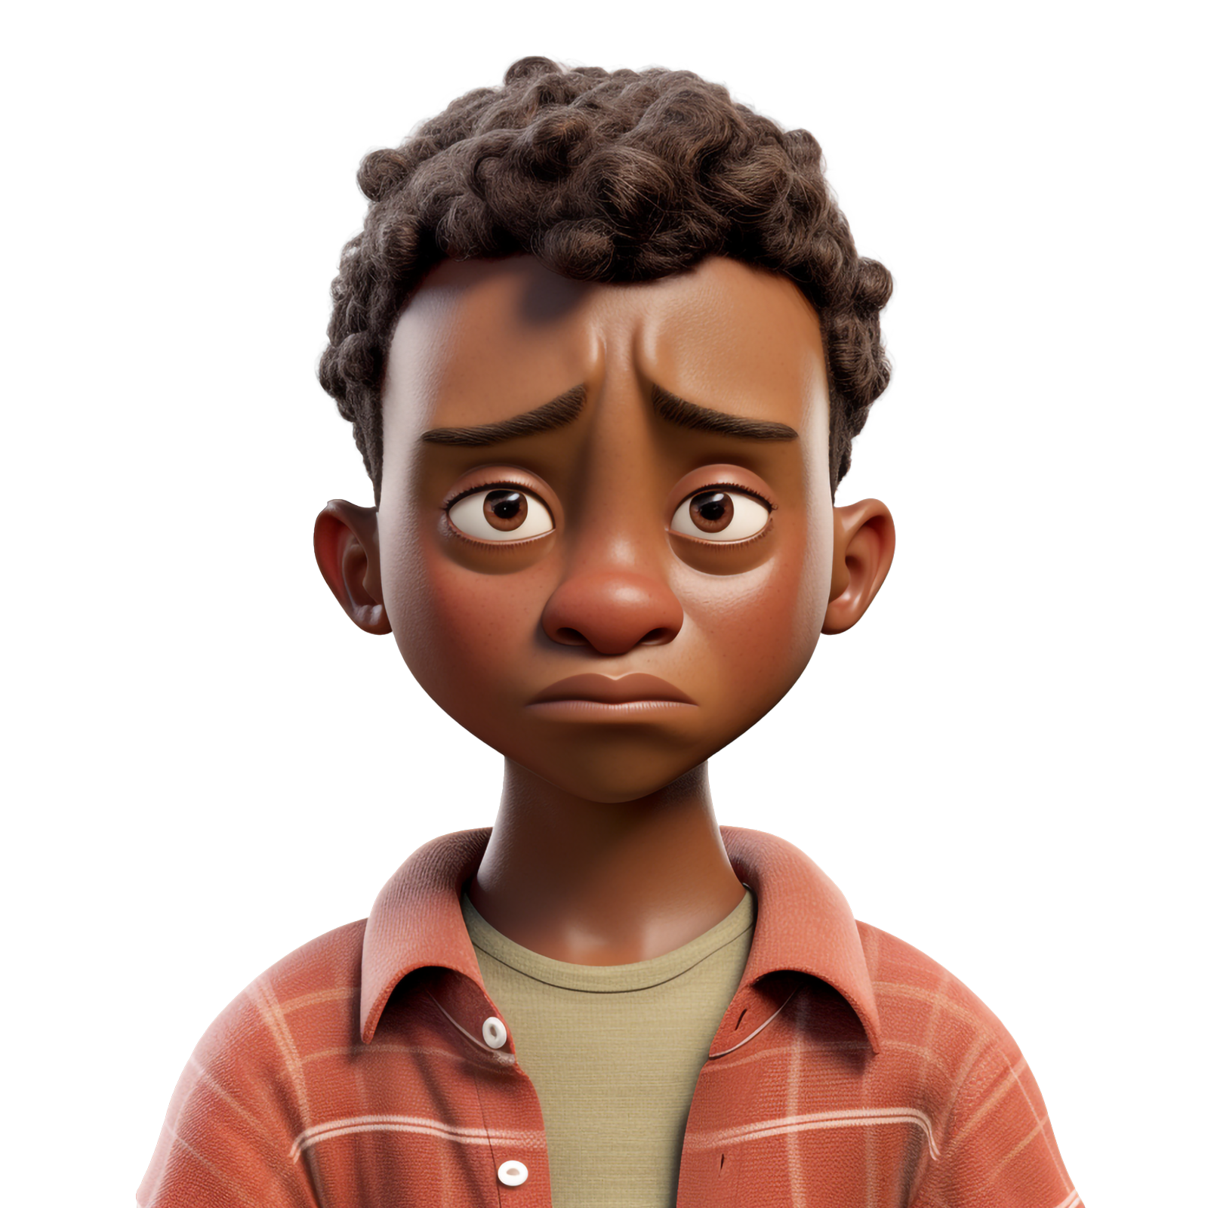
Sad Kid - Do not delete – used for Hyperlink
Sad Kid
It's important to recognize that children can exhibit signs of sadness or depression in various ways, and not all signs may be present in every case. If you suspect a child might be sad or depressed, it's crucial to approach the situation with empathy, open communication, and consideration for their feelings. Here are some potential signs to look out for:
Persistent Sadness: The child may appear consistently sad, tearful, or irritable, and this mood doesn't seem to improve over time.
Low Energy: They may seem lethargic, lack enthusiasm for activities, or appear physically tired even without engaging in much activity.
Social Isolation: Depressed children might withdraw from friends, family, and social activities that were previously enjoyed.

Slide 3
Happy Kid - Do not delete – used for Hyperlink
Happy Kid
A happy kid is more likely to be healthier because emotional well-being and physical health are interconnected. Here are some ways to ensure that a happy kid maintains good health:
Physical Activity: Encourage regular physical activity through play, sports, and outdoor activities. Physical exercise not only supports physical health but also releases endorphins, which contribute to a happier mood.
Limit Screen Time: Set limits on screen time, especially for devices like smartphones, tablets, and computers. Excessive screen time can negatively impact both physical and emotional health.
Adequate Sleep: Ensure that your child gets enough sleep according to their age. Sleep is crucial for growth, cognitive development, and emotional stability.

Slide 4
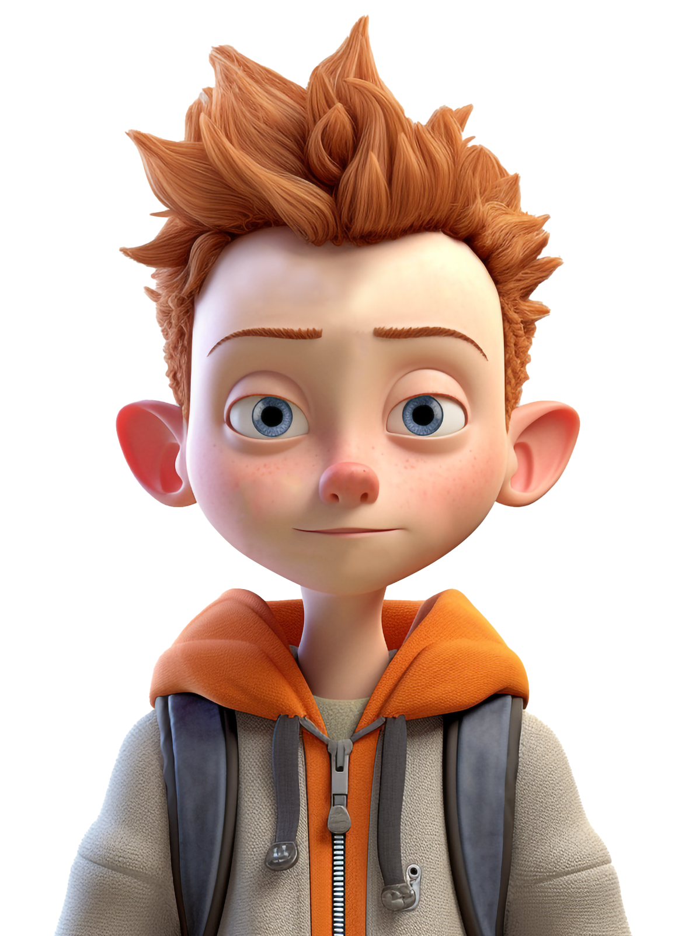
Emotionless Kid - Do not delete – used for Hyperlink
Emotionless Kid
A kid who doesn't show any emotion might be experiencing a range of factors that contribute to their emotional expression or lack thereof. It's important to approach this situation with empathy and sensitivity, as there could be various reasons for this behavior. Here are a few possible explanations:
Personality: Some individuals naturally have a more reserved or stoic personality, and they might not show emotions as overtly as others.
Environmental Factors: The child's home environment, relationships with family members, or peer interactions could impact their emotional expression. If they feel unsafe or unsupported, they might not feel comfortable showing their emotions.

Slide 5
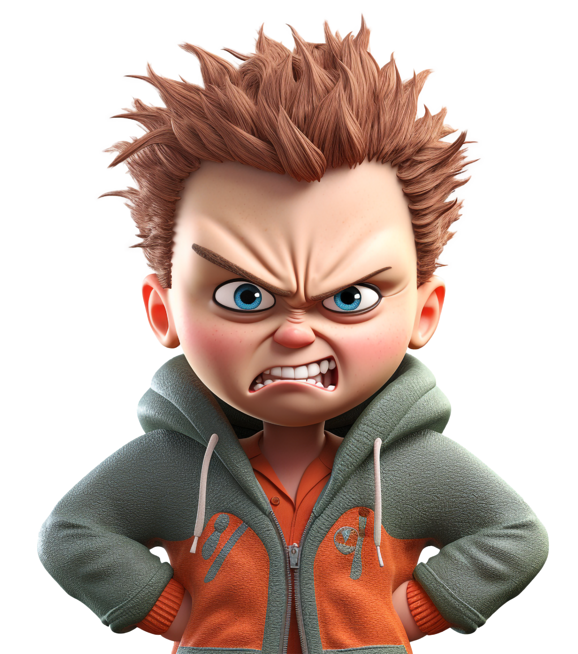
Angry Kid - Do not delete – used for Hyperlink
ANGRY KID
Recognizing anger issues in a child can be important for their emotional well-being and for helping them develop healthy coping mechanisms. Here are some signs to look out for that might indicate a child is struggling with anger issues:
Frequent and Intense Outbursts: Children with anger issues might have frequent and intense tantrums or outbursts that seem disproportionate to the situation.
Physical Aggression: Children with anger issues might engage in physical aggression, such as hitting, biting, or throwing objects when they are angry.
Impulsivity: Children with anger issues might act without thinking when they're angry, making impulsive decisions that they later regret.

Slide 6
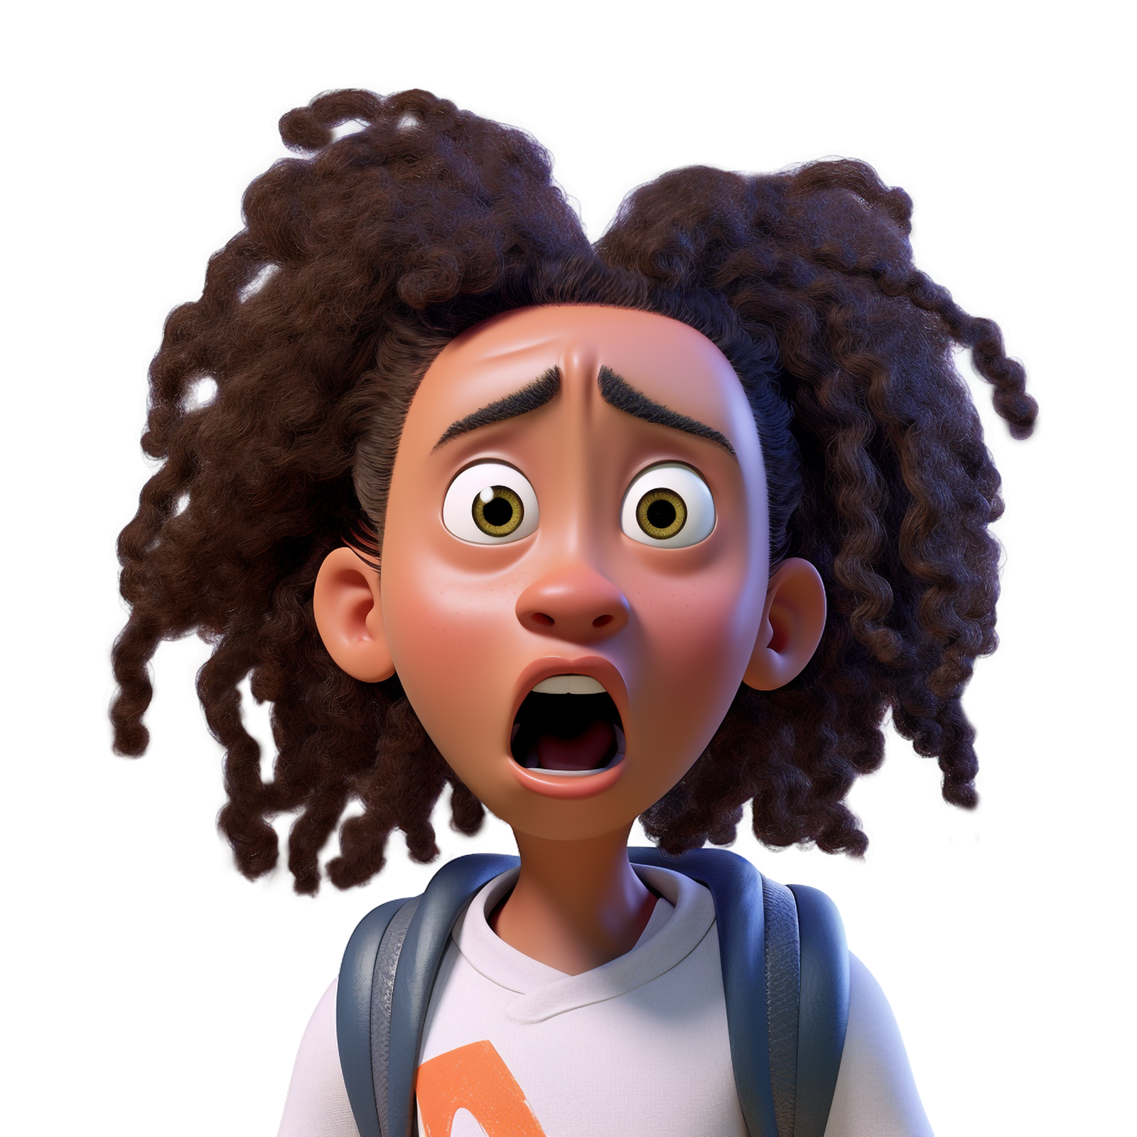
Scared Kid - Do not delete – used for Hyperlink
Scared Kid
Recognizing a scared kid involves paying attention to their behavior, body language, and verbal cues. Children often express fear in different ways than adults do. Here's what you can do:
Create a Safe Environment: Ensure the child feels physically and emotionally safe. Remove or reduce the source of fear if possible.
Offer Reassurance: Let the child know that their feelings are valid and that you are there to support them.
Professional Help: If the fear persists and significantly affects the child's daily life, consider seeking the advice of a pediatrician, therapist, or counselor.

Slide 7
Changing theme Colors in PowerPoint 2013 and newer
4. Select Customize Colors.
1. Click on the design tab
3. Select Colors
2. Select This Arrow

Slide 8
Changing theme Colors in PowerPoint 2010
3. Create New Theme Colors.
2. Select Colors
1. Click on the design tab

Slide 9
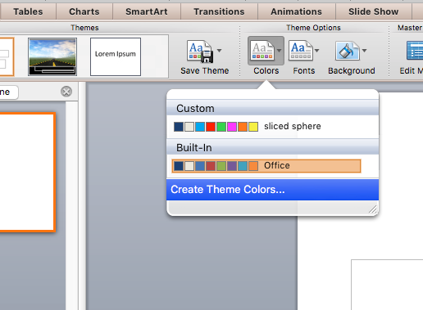
Changing theme Colors in PowerPoint Mac 2011
1. Expand Document Theme
2. Click Create Theme Colors
3. Change Accent Colors

Slide 10
Changing theme ACCENT Colors
All the accents plus the Text/Background-Dark2 are what control the colors in this template.
Left click on a color drop down to bring up the colors.
The top square that is highlighted is the main color, select it and change its color.
Click on More Colors to edit RBG values and select new colors.
Create a new name for your theme and click the save button at the bottom.

Slide 11
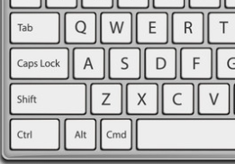
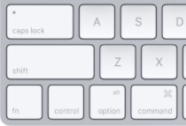
Remove Animation from any slide
1. Go to the slide you would like to remove the animation from.
3. With everything on that slide selected, go to the animation menu and select None.
2. Hold Ctrl and press a on you keyboard to select all.
If on a Mac hold Command and press a.

Slide 12
Questions? More Information?
PresenterMedia.com
support@presentermedia.com
(605) 274-2424

