Slide 1
Take a Break!
Be back in
09
59
58
57
56
55
54
53
52
51
50
49
48
47
46
45
44
43
42
41
40
39
38
37
36
35
34
33
32
31
30
29
28
27
26
25
24
23
22
21
20
19
18
17
16
15
14
13
12
11
10
09
08
07
06
05
04
03
02
01
00
:
Minutes
*** Use all slides for a 10-minute countdown - Remove this Text Box

Slide 2
Take a Break!
Be back in
08
59
58
57
56
55
54
53
52
51
50
49
48
47
46
45
44
43
42
41
40
39
38
37
36
35
34
33
32
31
30
29
28
27
26
25
24
23
22
21
20
19
18
17
16
15
14
13
12
11
10
09
08
07
06
05
04
03
02
01
00
:
Minutes
*** Delete slide (1) for an 9 - minute countdown - Remove this Text Box

Slide 3
Take a Break!
Be back in
07
59
58
57
56
55
54
53
52
51
50
49
48
47
46
45
44
43
42
41
40
39
38
37
36
35
34
33
32
31
30
29
28
27
26
25
24
23
22
21
20
19
18
17
16
15
14
13
12
11
10
09
08
07
06
05
04
03
02
01
00
:
Minutes
*** Delete slide (1 & 2 ) for a 8 - minute countdown - Remove this Text Box

Slide 4
Take a Break!
Be back in
06
59
58
57
56
55
54
53
52
51
50
49
48
47
46
45
44
43
42
41
40
39
38
37
36
35
34
33
32
31
30
29
28
27
26
25
24
23
22
21
20
19
18
17
16
15
14
13
12
11
10
09
08
07
06
05
04
03
02
01
00
:
Minutes
*** Delete slides ( 1 – 3 ) for a 7 - minute countdown - Remove this Text Box

Slide 5
Take a Break!
Be back in
05
59
58
57
56
55
54
53
52
51
50
49
48
47
46
45
44
43
42
41
40
39
38
37
36
35
34
33
32
31
30
29
28
27
26
25
24
23
22
21
20
19
18
17
16
15
14
13
12
11
10
09
08
07
06
05
04
03
02
01
00
:
Minutes
*** Delete slides ( 1 - 4) for a 6 - minute countdown - Remove this Text Box

Slide 6
Take a Break!
Be back in
04
59
58
57
56
55
54
53
52
51
50
49
48
47
46
45
44
43
42
41
40
39
38
37
36
35
34
33
32
31
30
29
28
27
26
25
24
23
22
21
20
19
18
17
16
15
14
13
12
11
10
09
08
07
06
05
04
03
02
01
00
:
Minutes
*** Delete slides ( 1- 5 ) for a 5 - minute countdown - Remove this Text Box

Slide 7
Take a Break!
Be back in
03
59
58
57
56
55
54
53
52
51
50
49
48
47
46
45
44
43
42
41
40
39
38
37
36
35
34
33
32
31
30
29
28
27
26
25
24
23
22
21
20
19
18
17
16
15
14
13
12
11
10
09
08
07
06
05
04
03
02
01
00
:
Minutes
*** Delete slides ( 1 - 6 ) for a 4 - minute countdown - Remove this Text Box

Slide 8
Take a Break!
Be back in
02
59
58
57
56
55
54
53
52
51
50
49
48
47
46
45
44
43
42
41
40
39
38
37
36
35
34
33
32
31
30
29
28
27
26
25
24
23
22
21
20
19
18
17
16
15
14
13
12
11
10
09
08
07
06
05
04
03
02
01
00
:
Minutes
*** Delete slides ( 1 - 7 ) for a 3 - minute countdown - Remove this Text Box

Slide 9
Take a Break!
Be back in
01
59
58
57
56
55
54
53
52
51
50
49
48
47
46
45
44
43
42
41
40
39
38
37
36
35
34
33
32
31
30
29
28
27
26
25
24
23
22
21
20
19
18
17
16
15
14
13
12
11
10
09
08
07
06
05
04
03
02
01
00
:
Minutes
*** Delete slides ( 1 - 8 ) for a 2 - minute countdown - Remove this Text Box

Slide 10
Take a Break!
Be back in
00
59
58
57
56
55
54
53
52
51
50
49
48
47
46
45
44
43
42
41
40
39
38
37
36
35
34
33
32
31
30
29
28
27
26
25
24
23
22
21
20
19
18
17
16
15
14
13
12
11
10
09
08
07
06
05
04
03
02
01
00
:
Seconds
*** Delete slides ( 1 - 9 ) for a 1 - minute countdown - Remove this Text Box

Slide 11
Welcome Back!
Please Find Your Seat
00
00
:
*** Optional Ending Slide - Remove this Text Box

Slide 12
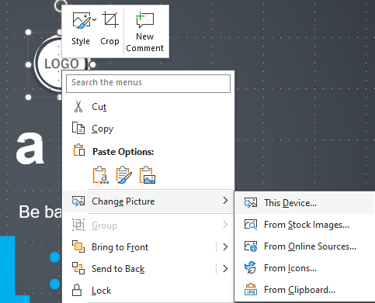
Replacing the Logo in this Template
1. Right click on the picture.
2. Choose either Change Graphic or Change Picture from the options.
3. Then choose This Device from the options.

Slide 13
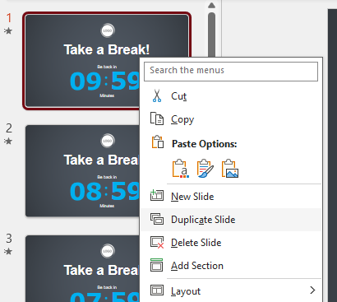
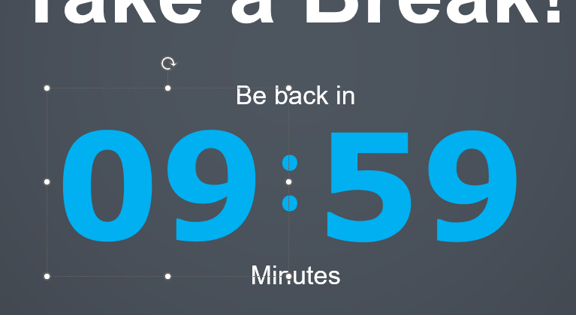
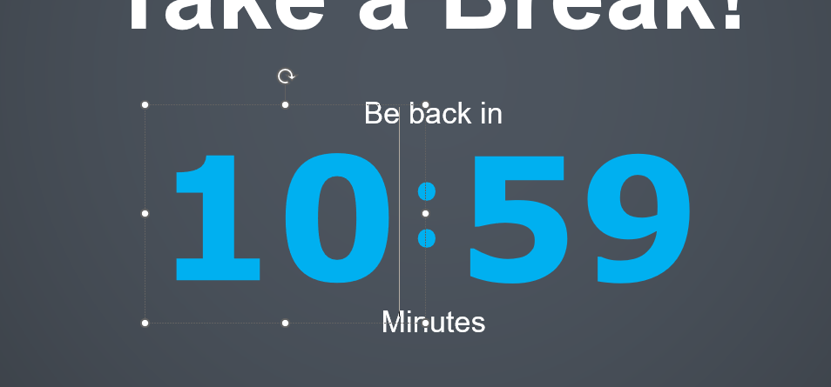
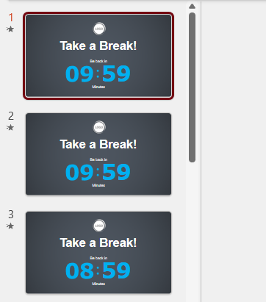
Add More Minutes to the Countdown
Step 1. Right - click on the top slide and choose “Duplicate Slide” from the menu.
Step 3. Change the
09
to a
10
Step 2. Select the duplicated slide which will not be the top slide.
Step 4. If needed, Repeat these steps but change the 10 to an 11.

Slide 14
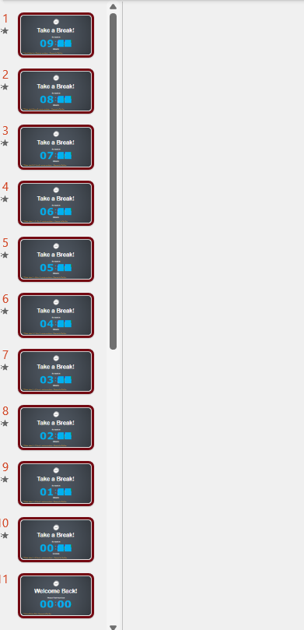
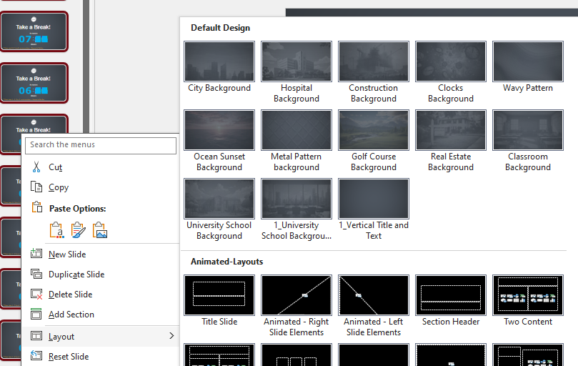
Choose a Background image for your timer
Click on the first thumbnail to select it.
Then, hold down shift on the keyboard and select the last thumbnail. This will select all in between.
With all the thumbnails now selected, right-click on any selected thumbnail and hover your mouse over Layout from the menu.
Last, select a background from the background slides available.
The background now appears behind the countdown.

Slide 15
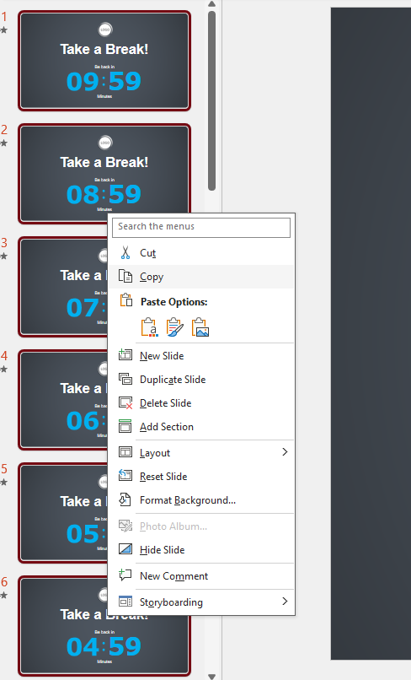
Copy and Paste Slides into Existing Presentation
Step 1. Holding Shift on your keyboard left mouse click all the thumbnail slides you want to copy. When they are selected, they will show up highlighted in yellow.
Step 2. Now right mouse click on any of the highlighted thumbnail slides and select copy.
Step 3. Now go to the template you want to copy the countdown slide to. Right mouse click between thumbnails where you would like the slides to be inserted.
Step 4. Click the middle icon in the Paste Options. This is the keep source formatting option.
*NOTE* To use the layout from the template you are copying to, select the first paste option called “destination Theme *

Slide 16
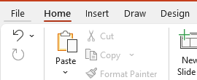
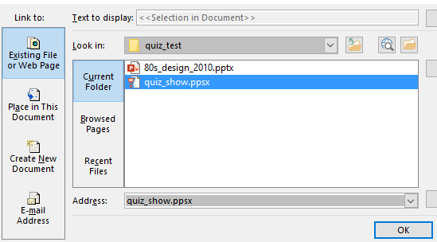
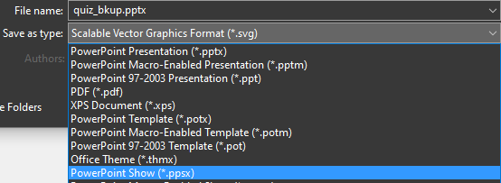
Save As a PowerPoint Show
If you don’t want to include all these game show slides in your main presentation, but still want to access the gameshow from your main presentation, follow these steps.
1. Go to File in the top menu.
2. Choose Save As and click Browse from This PC.
5. Choose Existing File > Current Folder > Choose the .ppsx file you saved from step 3.
3. Click the Save as type: drop down options. Choose PowerPoint Show (.pptx). NOTE* Save file to your computer in the same folder where your main presentation is saved.
4. Open your main presentation you would like to insert the countdown into. Make a new Text box on a slide and call it something like “Time for a Break”.
Right click on the text box and choose Link from the menu.
6. Preview Slide Show and click on the “Time for a Break” text and the countdown should appear. To exit the quick hit Esc on your keyboard.
NOTE* You can also use a linked image instead of text. Follow the same steps.

Slide 17
Changing theme Colors in PowerPoint 2013 and newer
4. Select Customize Colors.
1. Click on the design tab
3. Select Colors
2. Select This Arrow

Slide 18
Changing theme Colors Continued…
Customize the accent colors
All the accents plus the Text/Background-Dark2 are what control the colors in this template.
Left click on a color drop down to bring up the colors.
The top square that is highlighted is the main color, select it and change its color.
Click on More Colors to edit RBG values and select new colors.
Create a new name for your theme and click the save button at the bottom.

Slide 19
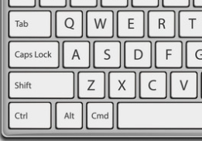
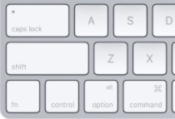
Remove Animation from any slide
1. Go to the slide you would like to remove the animation from.
3. With everything on that slide selected, go to the animation menu and select None.
2. Hold Ctrl and press a on you keyboard to select all.
If on a Mac hold Command and press a.

Slide 20
Questions? More Information?
PresenterMedia.com
support@presentermedia.com
(605) 274-2424

